Slide 1
Challenging problems

Slide 2

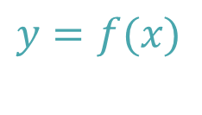



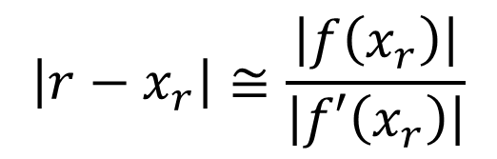

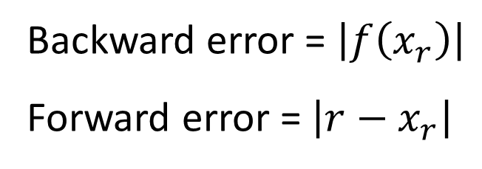
Forward and backward errors
$$y$$
$$y=f(x)$$
Backward error = $\left|f\left(x_{r}\right)\right|$
Forward error = $\left|r−x_{r}\right|$
$$f\left(x_{r} \right)$$
Backward Error
$$\left|r−x_{r}\right|≅\frac{\left|f\left(x_{r}\right)\right|}{\left|f′\left(x_{r}\right)\right|}$$
$$r$$
$$x_{r}$$
$$x$$
Forward Error
Notes:
In this lecture we are going to discuss some equations that are very challenging to solve numerically
One of such equation we have already encountered in previous lectures. It was the equation sin(x)=x which always gave us troubles when estimating the numerical errors.
In this lecture we are going to learn why this equation is such a trouble maker and how we should deal with it in numerical methods
Let us recall the concepts of backward and forward errors.
Consider a root finding problem of a function f(x).
The root we want to find is r and an algorithm did generate an approximation xr.
The backward error is f(xr). This quantity is always available and can, for a given approximation xr, easily be computed.
But what one is really interested in, is how far away the approximation is from the root. This is measured by the forward error defined as r-xr.
Contrary to the backward error, the forward error can not be computed and can only be estimated.
The estimation is given by f(xr) divided by f’(xr).

Slide 3
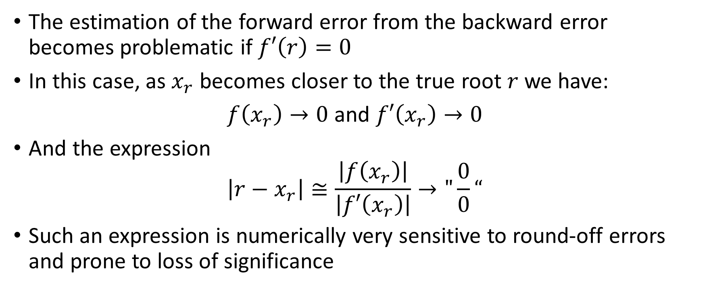
Numerical Issues
The estimation of the forward error from the backward error becomes problematic if $f′\left(r\right)=0$
In this case, as $x_{r}$ becomes closer to the true root $r$ we have:
$f\left(x_{r}\right)→0$ and $f′\left(x_{r}\right)→0$
And the expression
$$\left|r−x_{r}\right|≅\frac{\left|f\left(x_{r}\right)\right|}{\left|f′\left(x_{r}\right)\right|}→"\frac{0}{0}“$$
Such an expression is numerically very sensitive to round-off errors and prone to loss of significance
Notes:
The estimation of the forward error from the backward error becomes problematic if $f′\left(r\right)=0$
Indeed, in this situation, as $x_{r}$ becomes closer to the true root $r$, we have that at the same time f(xr) tends to zero and f’(xr) tends to zero too.
The expression we use to estimate the forward error becomes then an undermined division of zero by zero
Such an expression is numerically very sensitive to round-off errors and prone to loss of significance

Slide 4
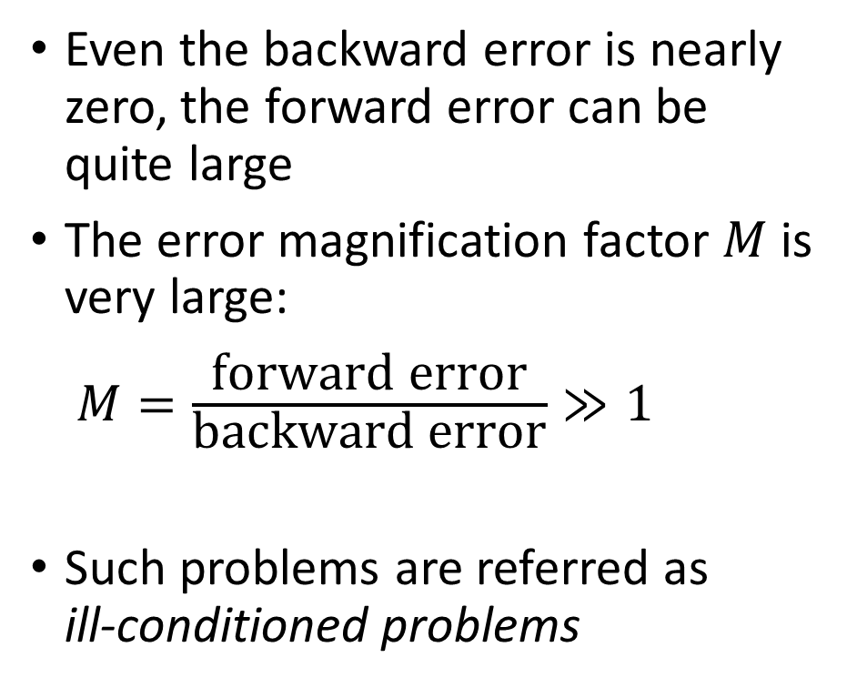



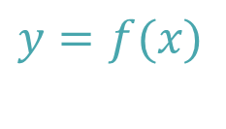
The Issue With Flat Functions
$$y$$
Even the backward error is nearly zero, the forward error can be quite large
The error magnification factor $M$is very large: $M=\frac{\text{forward} \text{error}}{\text{backward} \text{error}}≫1$
Such problems are referred as ill-conditioned problems
$$y=f(x)$$
$$r$$
$$x_{r}$$
Backward Error ≈ 0
$$x$$
Forward Error
Notes:
This problems happens with any function where f’(r) is zero.
Such functions are flat near the root r.
As illustrated on the figure, in such cases the forward error may be very large even if the backward error is nearly zero.
Alternatively one can say that the error magnification factor becomes very large
In numerical analysis problems with large error magnification factors are refereed to as ill-conditioned problems.
Let me stress out that if a problem is or is not ill-conditioned has nothing to do with the algorithm we use to find the root.
It has only to do with the fact that the error magnification factor is large which happens for functions flat round their root.
An ill-conditioned problem remains ill-conditioned regardless of which algorithm one may use to solve it.

Slide 5
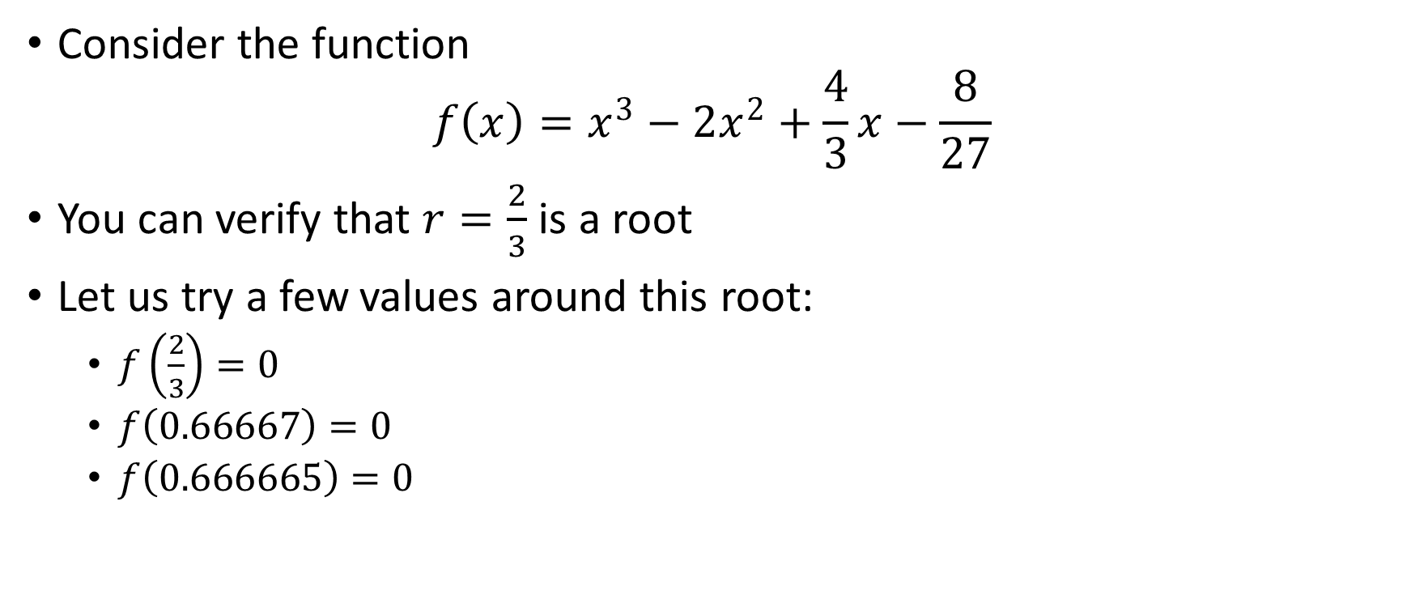
Example
Consider the function
$$f\left(x\right)=x^{3}−2x^{2}+\frac{4}{3}x−\frac{8}{27}$$
You can verify that $r=\frac{2}{3}$ is a root
Let us try a few values around this root:
$f\left(\frac{2}{3}\right)=0$
$f\left(0.66667\right)=0$
$f\left(0.666665\right)=0$
Notes:
Let us consider an example.
Consider the cubic function $f\left(x\right)=x^{3}−2x^{2}+\frac{4}{3}x−\frac{8}{27}$.
You can verify that $r=\frac{2}{3}$ is a root of this equation
Let us try a few values. I invite you to try them in Octave or on your hand calculator
Not surprisingly $f\left(\frac{2}{3}\right)=0$
But $f\left(0.66667\right)$ evaluates too to exactly zero
Same happens for $f\left(0.666665\right)$
How is this possible?

Slide 6
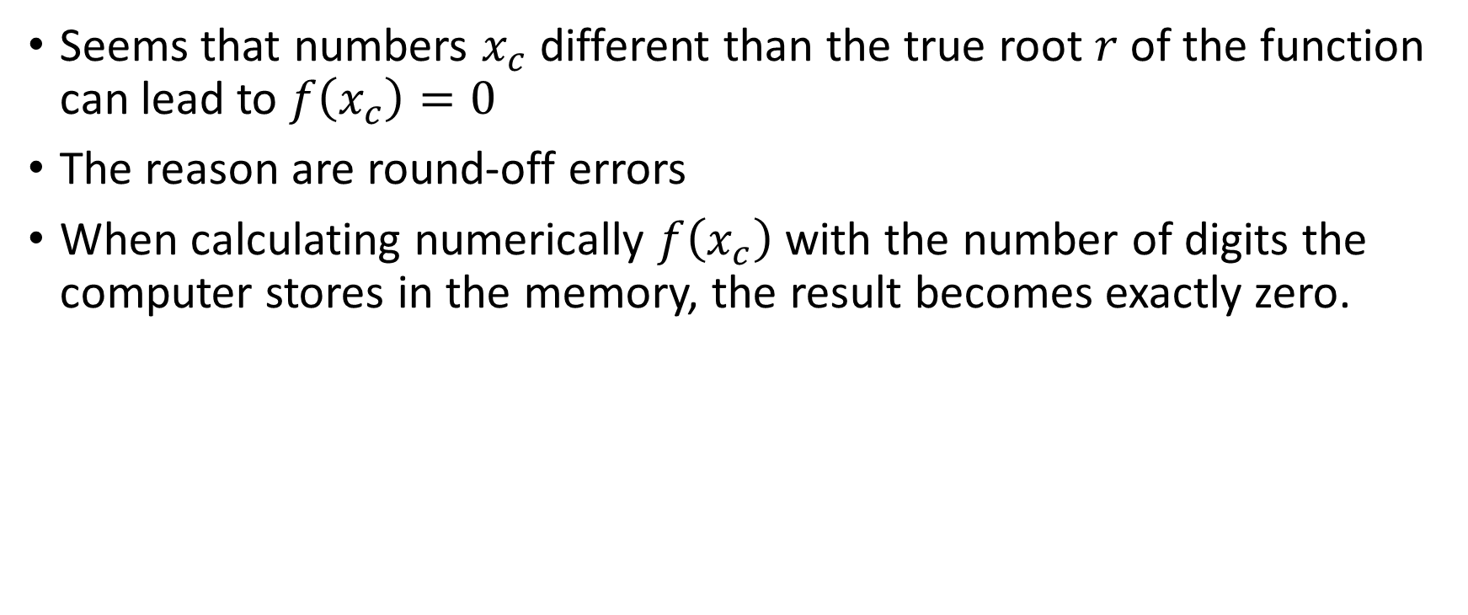
How is This Possible?
Seems that numbers $x_{c}$different than the true root $r$of the function can lead to $f\left(x_{c}\right)=0$
The reason are round-off errors
When calculating numerically $f\left(x_{c}\right)$with the number of digits the computer stores in the memory, the result becomes exactly zero.
Notes:
From our example, it looks like that there are numbers $x_{c}$different than the true root $r$of the function, that can lead to $f\left(x_{c}\right)=0$
The reasons are round-off errors.
When we evaluate f(xc), these round-off errors make that we get exactly zero, even if mathematically the function does not evaluate to zero.

Slide 7
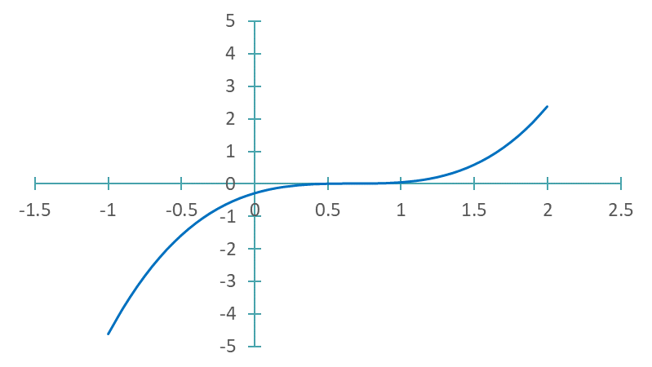
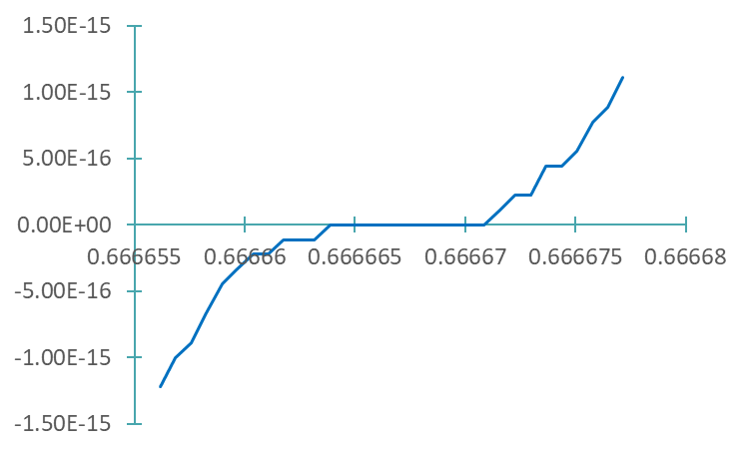
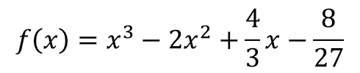
$$f\left(x\right)=x^{3}−2x^{2}+\frac{4}{3}x−\frac{8}{27}$$
Evaluates to zero exactly
Notes:
If we plot our function we can observe this very clearly
First we realize that the function is very flat around it’s root
If we zoom further into the function, the effect of the round-off errors become very apparent.
The computer does not evaluate the function in an infinitely precise way. The precision is limited by round-off errors.
The consequence is that the function appears no longer smooth but in a stair-case manner.
There is a region, which in our case is quite large, where the function will evaluate numerically to exactly zero.
The take away is that if a function evaluates numerical to zero in some point xc, this point xc does not have to be root of the function.
If the function is flat around the root r, then this point xc may even be fairly far away from that actual root.

Slide 8













Multiplicity of a Root
Definition
A root $r$ of a function $f\left(x\right)$ is said to be of multiplicity $m$ if $f\left(r\right)=0$, $f′\left(r\right)=0$, $f′′\left(r\right)=0$, … , $f^{(m−1)}\left(r\right)=0$, $f^{(m)}\left(r\right)≠0$
$$y$$
$$y$$
$$y$$
$$y=f(x)$$
$$y=f(x)$$
$$y=f(x)$$
$$r$$
$$x$$
$$r$$
$$x$$
$$r$$
$$x$$
Double Root
Triple Root
Quadruple Root
Notes:
The observation of the previous example tells us that functions that are flat around their root have a high error magnification factor and as such become challenging to deal with numerically when it comes to a root finding problem.
This observation motivates the definition of root multiplicity.
The definition reads:
A root $r$ of a function $f\left(x\right)$ is said to be of multiplicity $M$ if $f\left(r\right)=0$, $f′\left(r\right)=0$, $f′′\left(r\right)=0$, … , $f^{(m−1)}\left(r\right)=0$, $f^{(m)}\left(r\right)≠0$
For example a double root would be a case where we have f(r)=0 and f’(r)=0 but f”(r) is no longer zero.
Such a function will be flat around the root and the root must be either a maximum or minimum of the function, depending if it’s second derivative is positive or negative.
A typical shape of such a function is sketched on the figure
If we look to a triple root, we must further have that it’s second derivate evaluates to zero but the third derivative no longer evaluates to zero.
Such a function has an inflection point in the root.
A typical shape of such a function is sketched on the figure.
If we go to a quadruple root, we end-up again with a function presenting either a maximum or minimum at the root, but flatter than in the case of the double root.
From the figures it is clear that the higher the multiplicity of a root is, the flatter will be the function around the root.
Note as well that for roots of even multiplicity (2 and 4 in our figures) the function does not cross the x-axis.
For odd multiplicity (3 in our figure) the function will cross the x-axis.

Slide 9
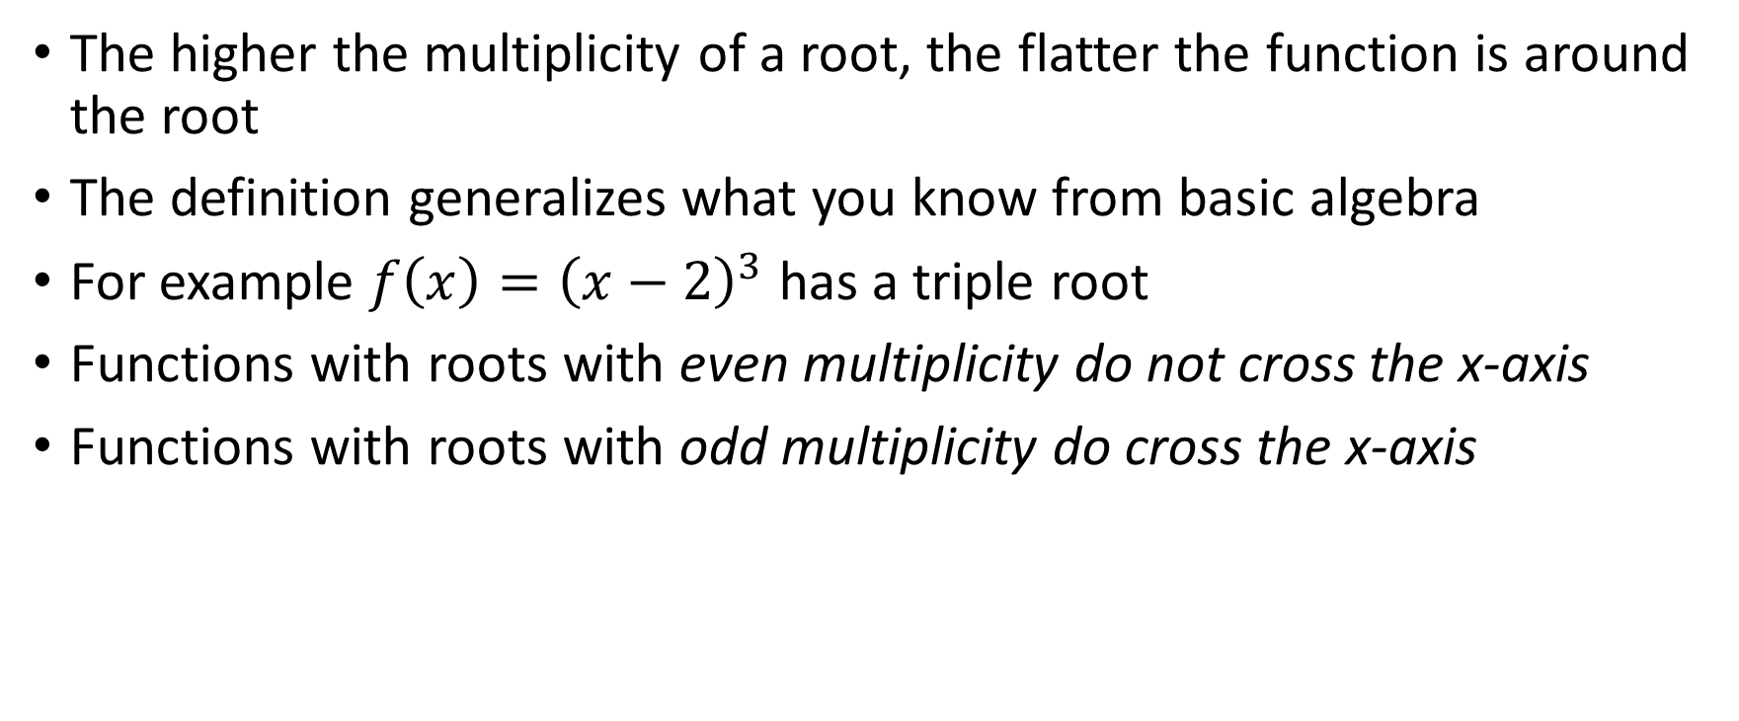
Comments
The higher the multiplicity of a root, the flatter the function is around the root
The definition generalizes what you know from basic algebra
For example $f\left(x\right)={\left(x−2\right)}^{3}$ has a triple root
Functions with roots with even multiplicity do not cross the x-axis
Functions with roots with odd multiplicity do cross the x-axis
Notes:
Let us add some comments about this definition.
As already discussed in the previous slide the function becomes flatter as the multiplicity of the root increases.
The definition generalizes what you already know from basic algebra.
Consider for example the function $f\left(x\right)={\left(x−2\right)}^{3}$.
From basic algebra, you would call the root r=3 a triple root of the cubic polynomial ${\left(x−2\right)}^{3}$.
I let you verify, by applying our definition for root multiplicity, that indeed f, it’s first and second derivative evaluates to zero in x=3. The third derivative will no longer evaluate to zero but you will find 6
This gives a root multiplicity M=3, as you expect from basic algebra.
As well :
Functions with roots with even multiplicity do not cross the x-axis
Functions with roots with odd multiplicity do cross the x-axis
This fact is very useful if you want to estimate the multiplicity of a root based on the plot of the function

Slide 10
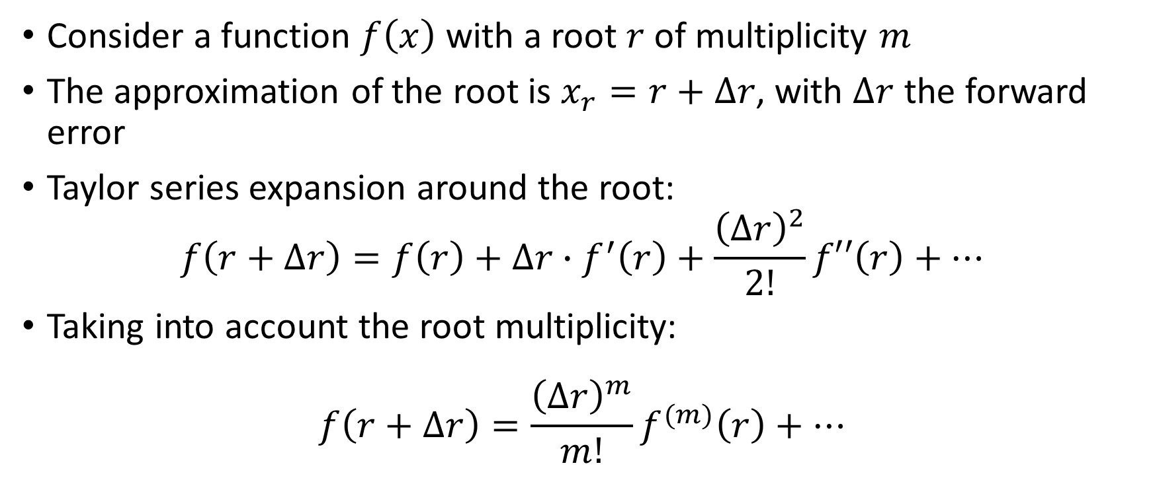
Forward Error Estimation For Roots of High Multiplicity
Consider a function $f\left(x\right)$ with a root $r$ of multiplicity $m$
The approximation of the root is $x_{r}=r+∆r$, with $∆r$ the forward error
Taylor series expansion around the root:
$$f\left(r+∆r\right)=f\left(r\right)+∆r∙f^{′}\left(r\right)+\frac{{\left(∆r\right)}^{2}}{2!}f′′\left(r\right)+…$$
Taking into account the root multiplicity:
$$f\left(r+∆r\right)=\frac{{\left(∆r\right)}^{m}}{m!}f^{(m)}\left(r\right)+…$$
Notes:
So far we learned that functions that are flat around their root, present a challenge for estimating the forward error because their first derivative evaluates to zero.
Let us now try to improve our formula for estimating the forward error for the case of a function with a root of multiplicity m
Imagine an algorithm did compute an approximation xr of this root.
We can then write $x_{r}=r+∆r$, with $∆r$ the forward error
Let us expand into a Taylor series the function f around it’s root r, meaning we want to expand $f\left(r+∆r\right)$
Recall that the root is of multiplicity m. This means that f’(r) is zero, but as well all derivatives until the derivative m-1.
The fist derivative that will not evaluate to zero fill be the mth derivative.
Consequently the Taylor series expansion writes as displayed on the slide

Slide 11
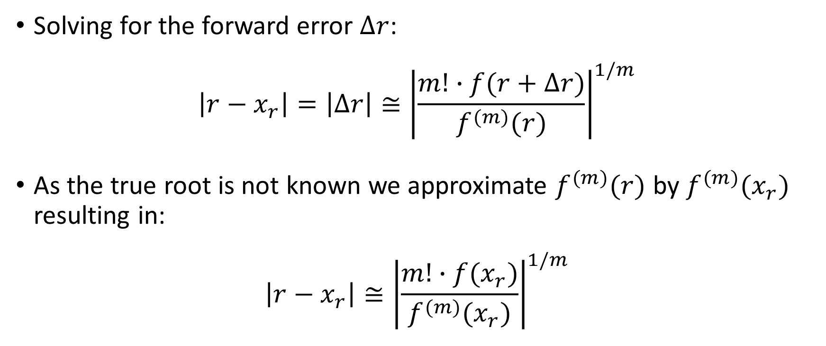
Forward Error Estimation For Roots of High Multiplicity
Solving for the forward error $∆r$:
$$\left|r−x_{r}\right|=\left|∆r\right|≅{\left|\frac{m!∙f(r+∆r)}{f^{(m)}(r)}\right|}^{1/m}$$
As the true root is not known we approximate $f^{(m)}(r)$ by $f^{(m)}(x_{r})$ resulting in:
$$\left|r−x_{r}\right|≅{\left|\frac{m!∙f(x_{r})}{f^{(m)}(x_{r})}\right|}^{1/m}$$
Notes:
Solving for the forward error $∆r$ gives us an estimation of it.
Now, in a real situation the true root r is not known. We will instead use it’s approximation xr provided by the algorithm
Using xr instead of r, leads us to the displayed formula that allows to estimate the forward error of an approximation xr of a root solving problem.

Slide 12
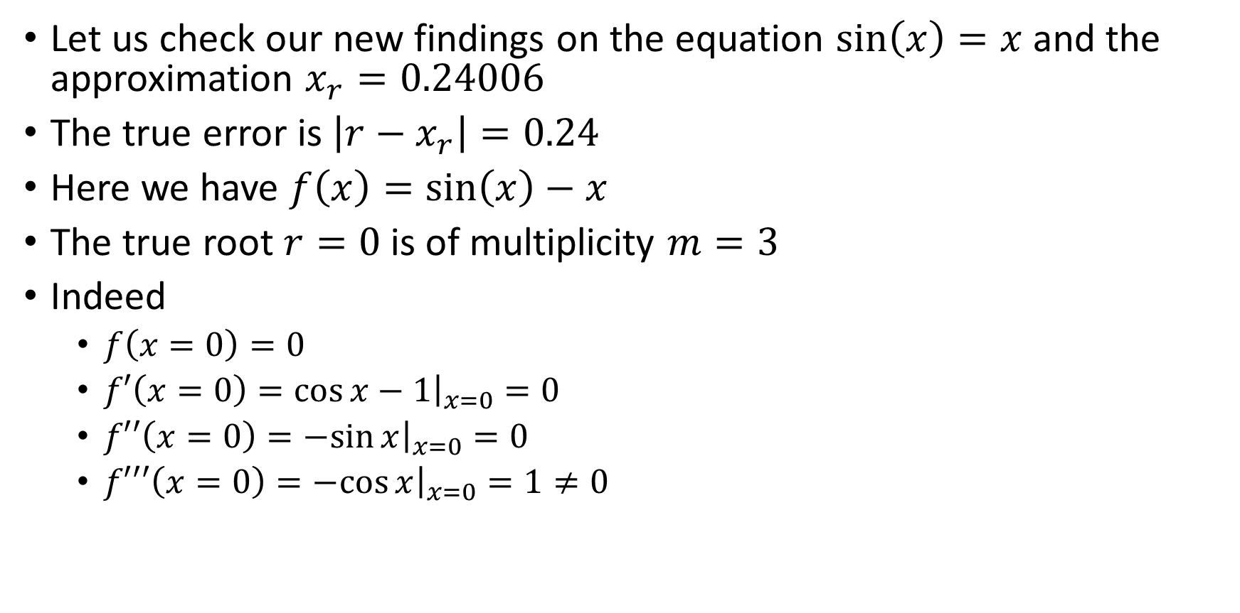
Application
Let us check our new findings on the equation $\sin\left(x\right)=x$ and the approximation $x_{r}=0.24006$
The true error is $\left|r−x_{r}\right|=0.24$
Here we have $f\left(x\right)=sin\left(x\right)−x$
The true root $r=0$ is of multiplicity $m=3$
Indeed
$f\left(x=0\right)=0$
$f′\left(x=0\right)={\left.\cos{x}−1\right|}_{x=0}=0$
$f′′\left(x=0\right)={\left.−sin{x}\right|}_{x=0}=0$
$f′′′\left(x=0\right)={\left.−cos{x}\right|}_{x=0}=1≠0$
Notes:
Let us apply this formula for an example
We use the trouble making equation sin(x)=x with the approximation $x_{r}=0.24006$
Here the true root is r=0 and consequently the true error is about 0.24.
The function f we look at is $f\left(x\right)=sin\left(x\right)−x$.
Let us now determine the multiplicity m of the root r=0.
It is simple to verify that m is three.
Indeed we have:
f(x=0)=0
The same holds for it’s first derivative and second derivative
It is only the third derivative which will evaluate to a none zero value.

Slide 13
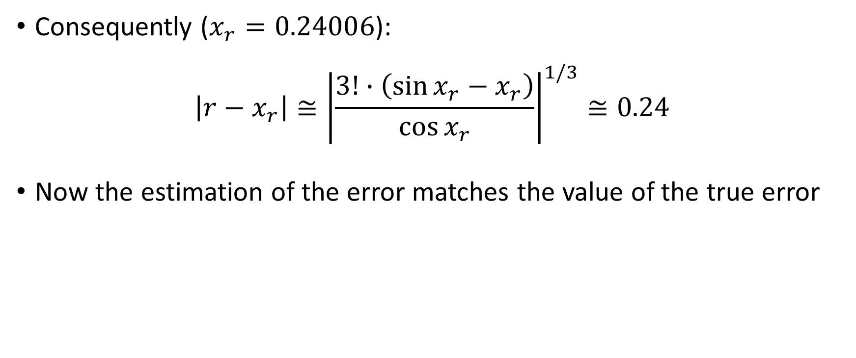
Application
Consequently ($x_{r}=0.24006$):
$$\left|r−x_{r}\right|≅{\left|\frac{3!∙\left(\sin{x_{r}}−x_{r}\right)}{\cos{x_{r}}}\right|}^{1/3}≅0.24$$
Now the estimation of the error matches the value of the true error
Notes:
Now we have all we need to estimate the forward error
Using our derived formula with $x_{r}=0.24006$ and m=3 we get an estimation for the forward error of 0.24
This value now matches very well the true error.

Slide 14
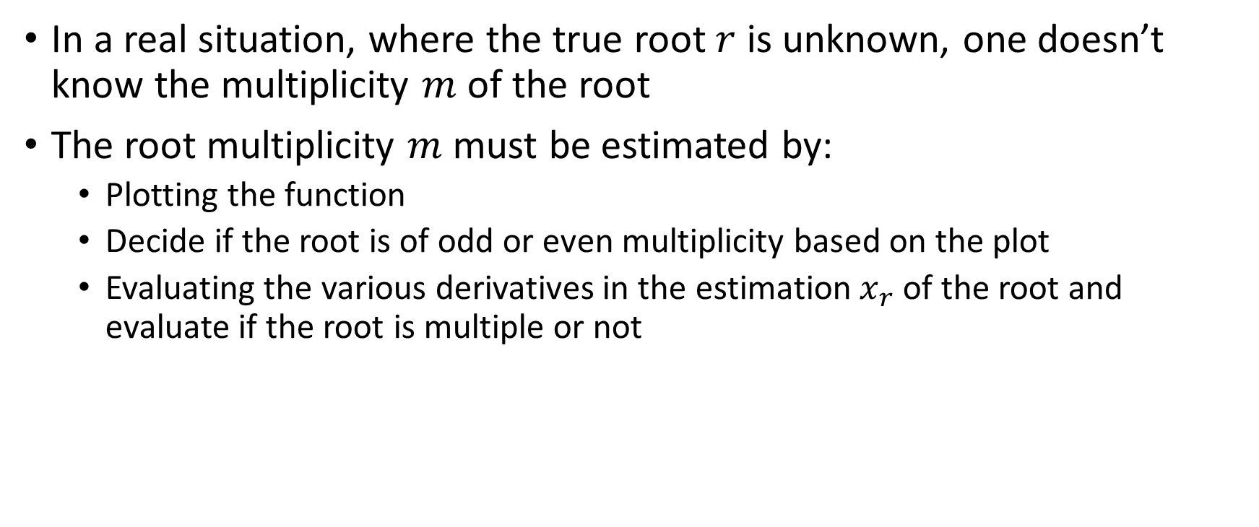
Estimating the multiplicity of the root
In a real situation, where the true root $r$ is unknown, one doesn’t know the multiplicity $m$ of the root
The root multiplicity $m$ must be estimated by:
Plotting the function
Decide if the root is of odd or even multiplicity based on the plot
Evaluating the various derivatives in the estimation $x_{r}$ of the root and evaluate if the root is multiple or not
Notes:
You may argue that in a real situation, where the true root $r$ is unknown, we do not know neither the multiplicity of the root
That is correct.
Consequently we will have to estimate the root’s multiplicity
We can do this by
First plotting the function
Second, based on the plot determine if the root is of odd or even multiplicity, depending if the function does or does not cross the x axis.
Third evaluate the derivatives of the function in xr in order to get an estimation of m.

Slide 15
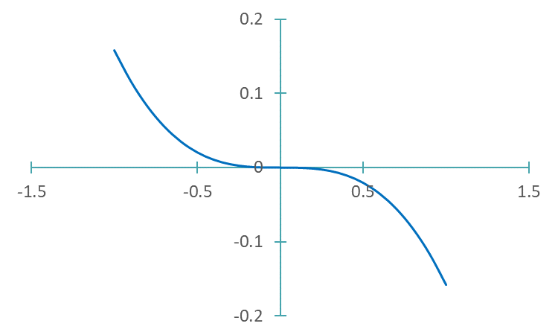


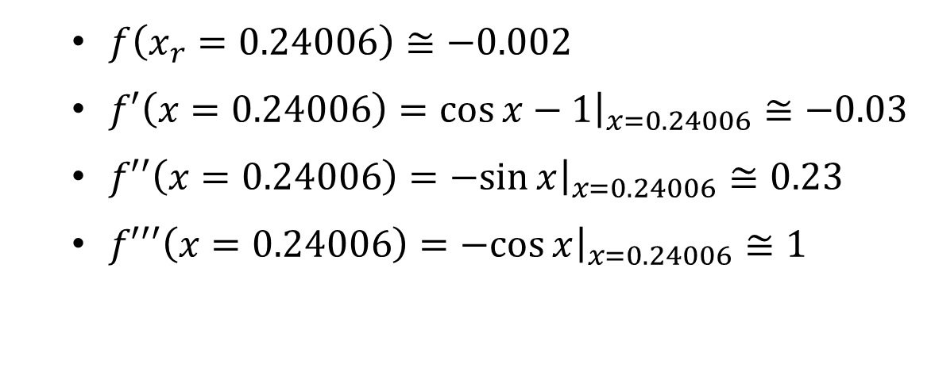
Estimating the multiplicity of the root
For our example $f\left(x\right)=sin\left(x\right)−x$ and $x_{r}=0.24006$ :
Consequently the root is most likely a triple root
$$y=\sin{x}−x$$
$f\left(x_{r}=0.24006\right)≅−0.002$
$f′\left(x=0.24006\right)={\left.\cos{x}−1\right|}_{x=0.24006}≅−0.03$
$f′′\left(x=0.24006\right)={\left.−sin{x}\right|}_{x=0.24006}≅0.23$
$f′′′\left(x=0.24006\right)={\left.−cos{x}\right|}_{x=0.24006}≅1$
Odd Multiplicity
Notes:
Let us estimate the multiplicity of the root of our function $f\left(x\right)=sin\left(x\right)−x$
First we plot the function
As the function does cross the x-axis, the root must be of odd multiplicity.
As further the function is quite flat at the root, it is likely the multiplicity will be higher than one.
Maybe 3 or 5
Let us now evaluate the function and it’s derivatives in xr and observe what happens.
First f(xr) gives about -0.002, very close to zero, showing that indeed we have a root somewhere around xr.
The first derivative evaluates to -0.03, still fairly close to zero. So probably the root is of higher multiplicity than one.
Second derivative evaluates to 0.23, but we know from the figure the multiplicity must be odd.
It can not be a double root.
However, the third derivative now clearly does no longer evaluate to zero. Showing the root is not higher than a triple root.
Based on these numbers, we can conclude that the root is most likely a triple root.
A single root seems unlikely due to the flatness of the function we see on the figure
A triple root seems more appropriate
As shows this example, the root multiplicity can be estimated, but it is not a straight forward task.

Slide 16
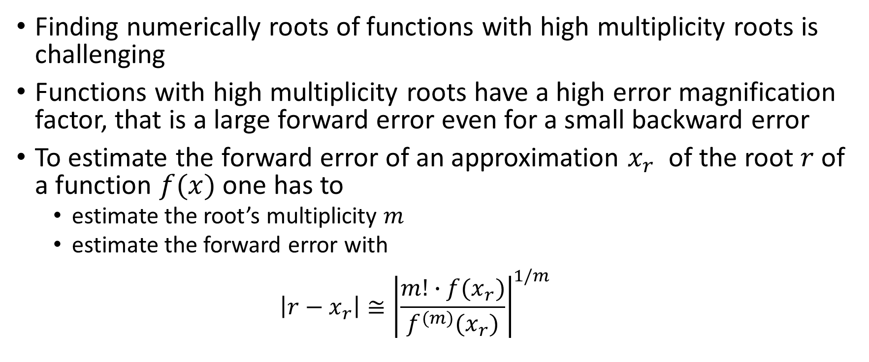
Summary
Finding numerically roots of functions with high multiplicity roots is challenging
Functions with high multiplicity roots have a high error magnification factor, that is a large forward error even for a small backward error
To estimate the forward error of an approximation $x_{r}$ of the root $r$ of a function $f(x)$ one has to
estimate the root’s multiplicity $m$
estimate the forward error with
$$\left|r−x_{r}\right|≅{\left|\frac{m!∙f(x_{r})}{f^{(m)}(x_{r})}\right|}^{1/m}$$
Notes:
Let us summarize our key findings
Finding numerically roots of functions with high multiplicity roots is challenging
Functions with high multiplicity roots have a high error magnification factor, that is a large forward error even for a small backward error
To estimate the forward error of an approximation $x_{r}$ of the root $r$ of a function $f(x)$ one has to
First to estimate the root’s multiplicity $m$
And second estimate the forward error with our derived formula.

